Slide 1
Mapping the Future of Mobility: EV Charging Patterns and Usage Trends
Submitted by
Chundru Rishith Sai Chowdary
12212330

Slide 2
ABOUT THE PROJECT :
This project is based on Analysis of the Electric vehicles charging patterns based on taken Dataset. With use of Dataset, I have created visualizations on some important aspects observed from the dataset.
It will give you the clear and concise view of data with the usage of dashboard.

Slide 3
Resources :
I have found this dataset from Kaggle Website: https://www.kaggle.com/datasets/valakhorasani/electric-vehicle-charging-patterns

Slide 4
Total Energy Consumed by Vehicle Model
Visualizes total energy consumption by each vehicle model, highlighting models with higher usage.

Slide 5
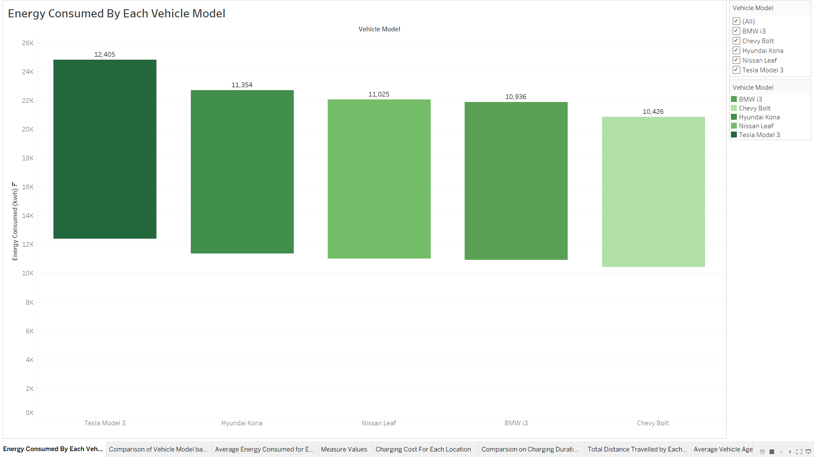

Slide 6
Average Distance Driven vs. Charging Rate
Compares average distance and charging rate per vehicle model, showing variations in efficiency.

Slide 7
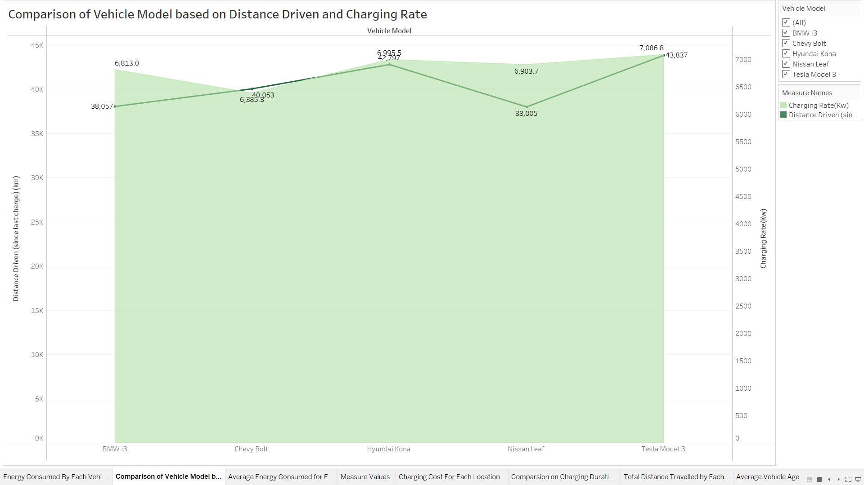

Slide 8
Average Energy Consumed by Location
Displays energy consumption by charging station location, identifying high-usage areas.

Slide 9
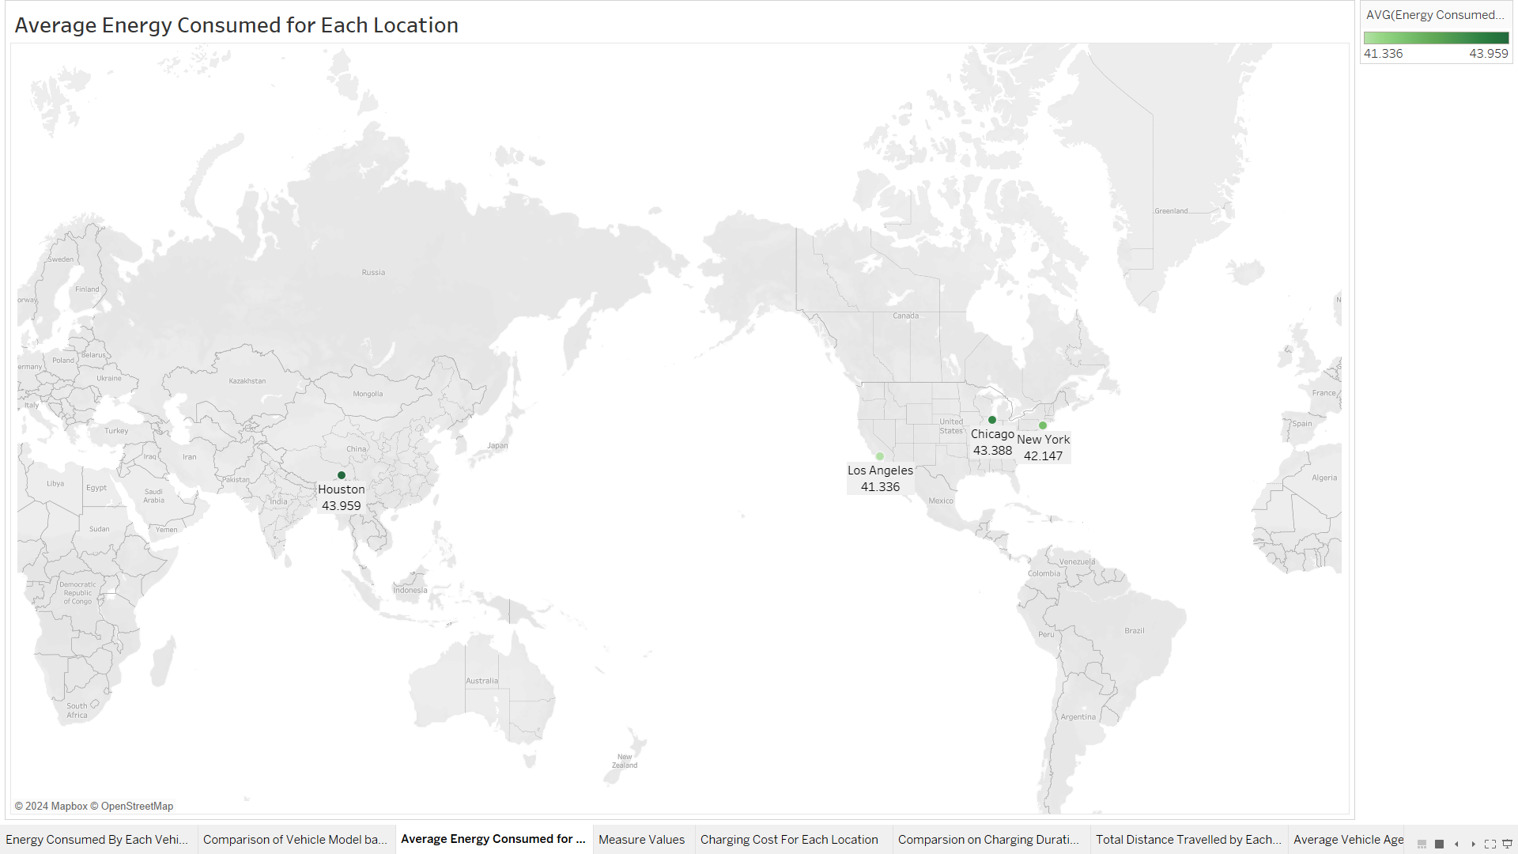

Slide 10
Measure Values
Highlights key metrics from the dataset for a quick overview.

Slide 11
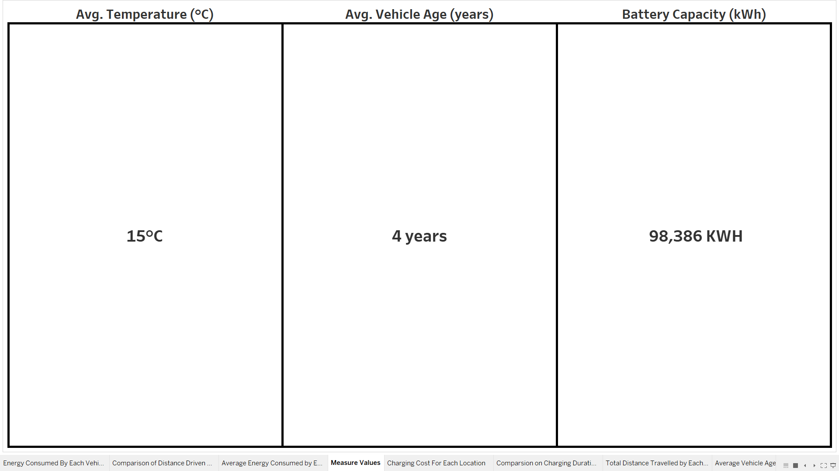

Slide 12
Average Charging Cost by Location
Tracks average charging costs across locations, revealing economical stations.

Slide 13
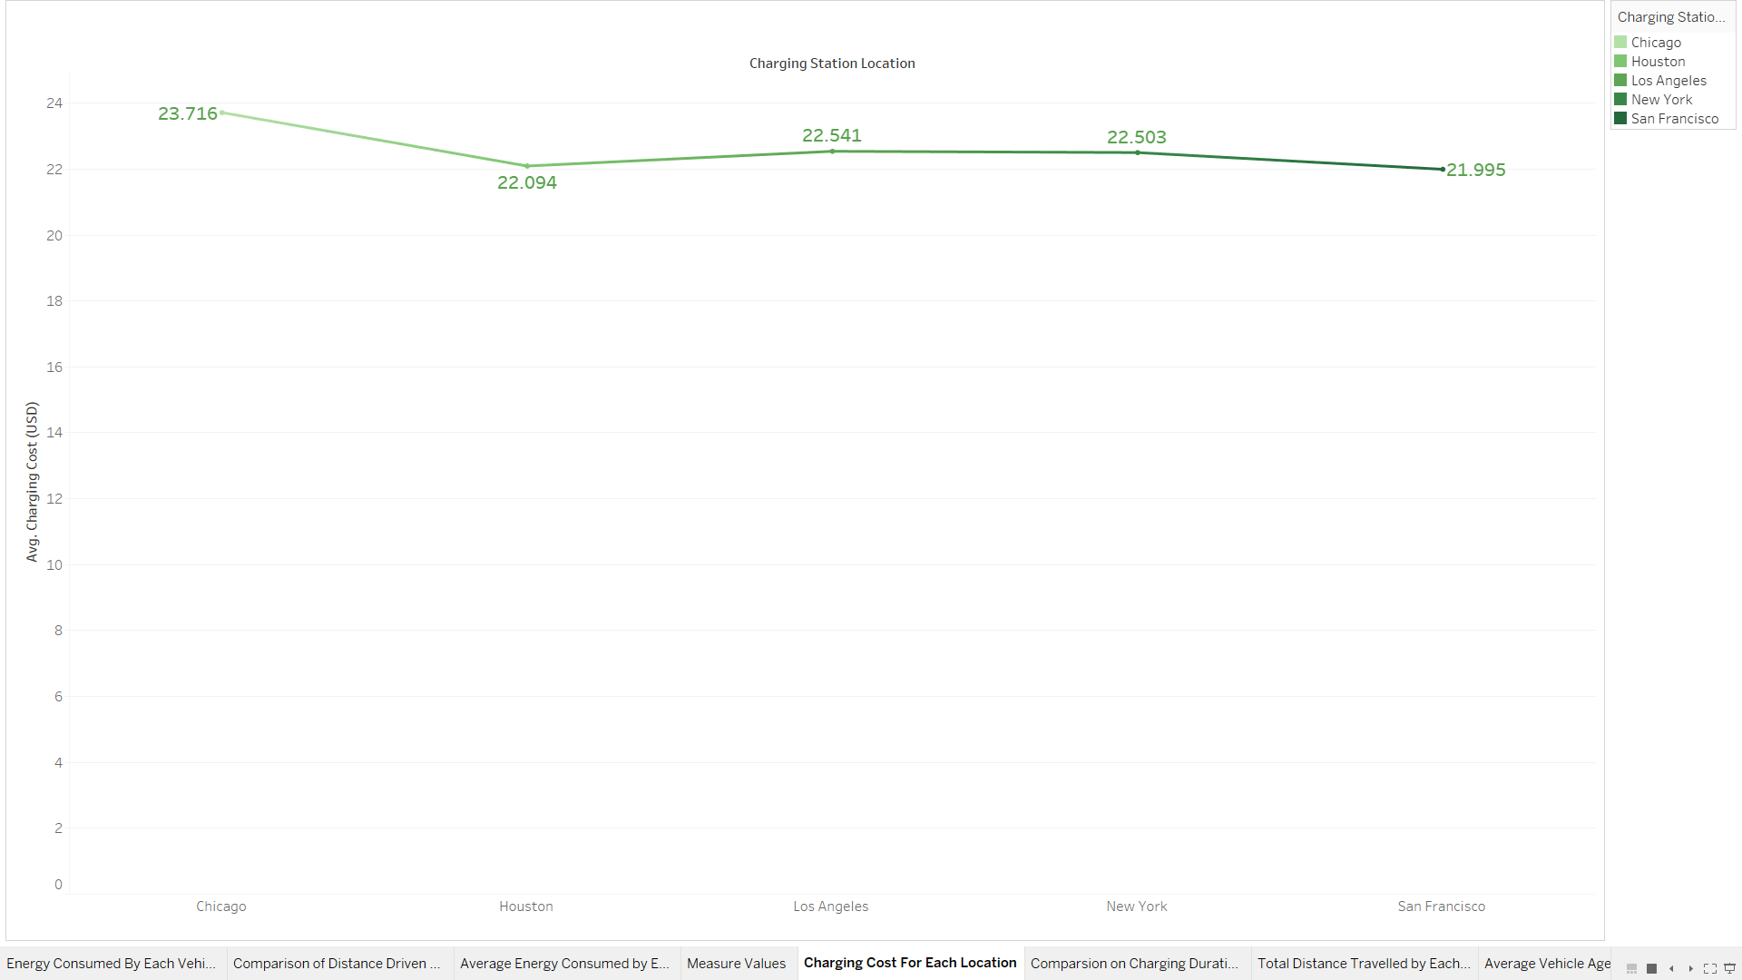

Slide 14
Comparison on Charging Duration and Rate by Location
Compares total charging duration and rate by location, showing high-demand areas.

Slide 15
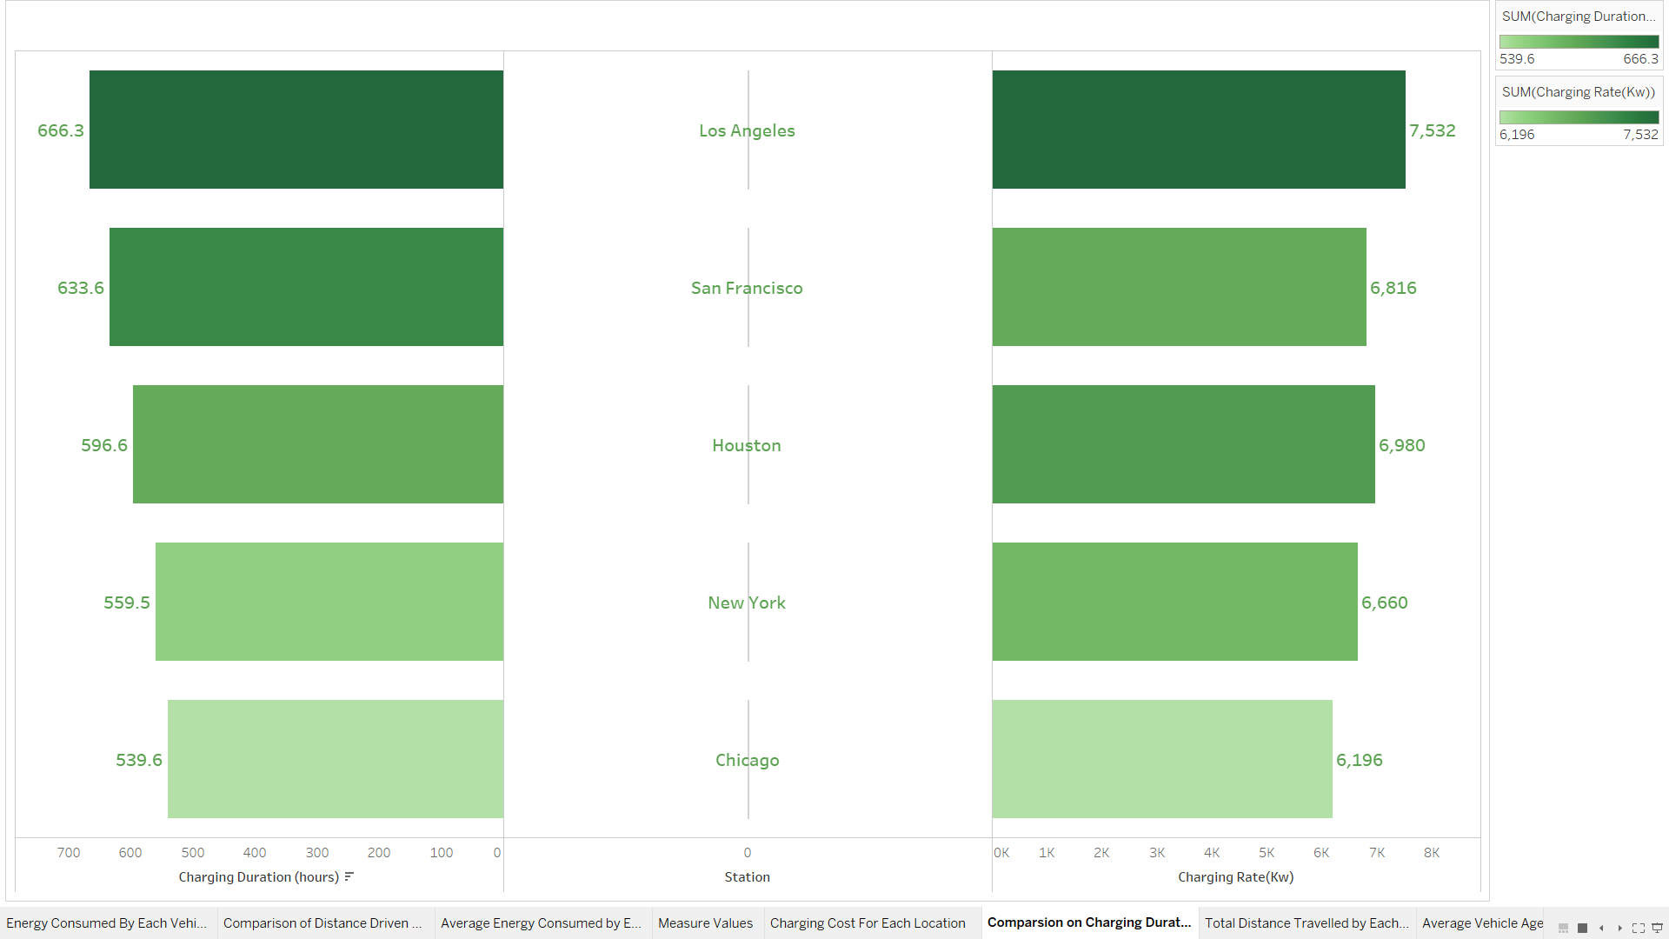

Slide 16
Total Distance Driven by Vehicle Model
Shows distance distribution across vehicle models, indicating models with longer ranges.

Slide 17
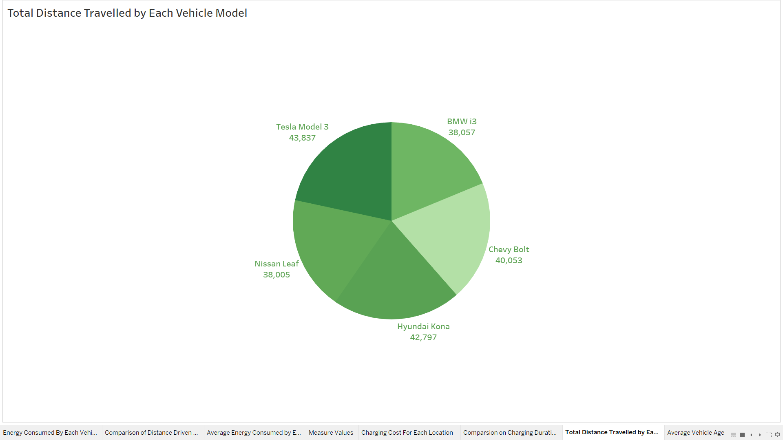

Slide 18
Average Vehicle Age by Model
Displays average age of each vehicle model, useful for understanding fleet demographics.

Slide 19
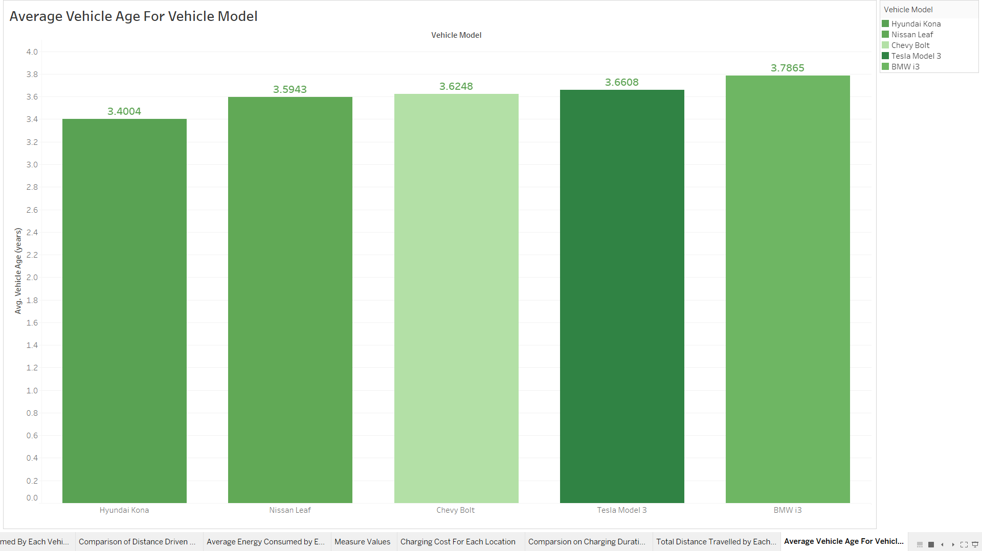

Slide 20
Total Charging Cost by Vehicle Model
Highlights charging cost distribution by vehicle model, useful for cost analysis.

Slide 21
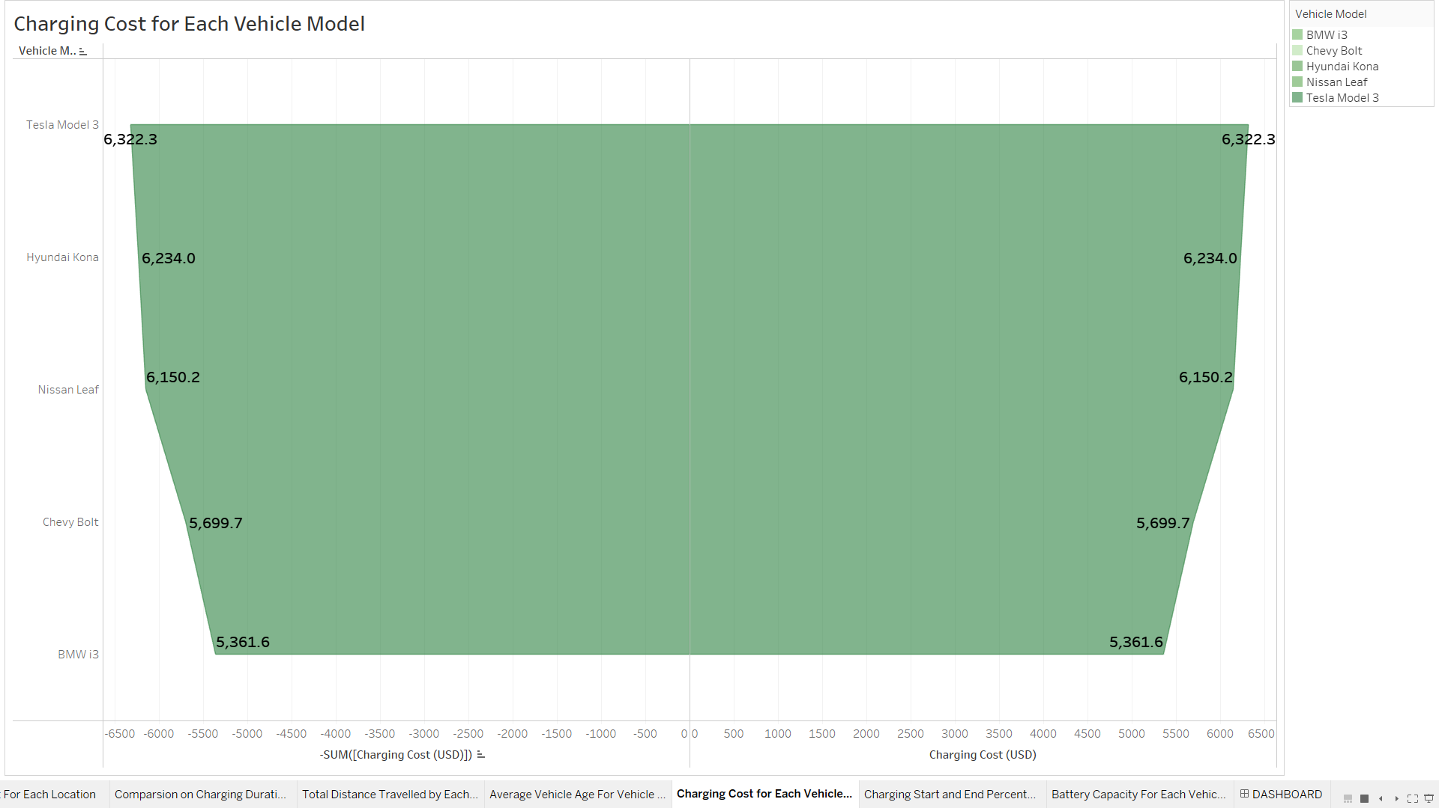

Slide 22
Charging Start vs. End Percentage
Compares start and end charging percentages, showing completion trends by model.

Slide 23
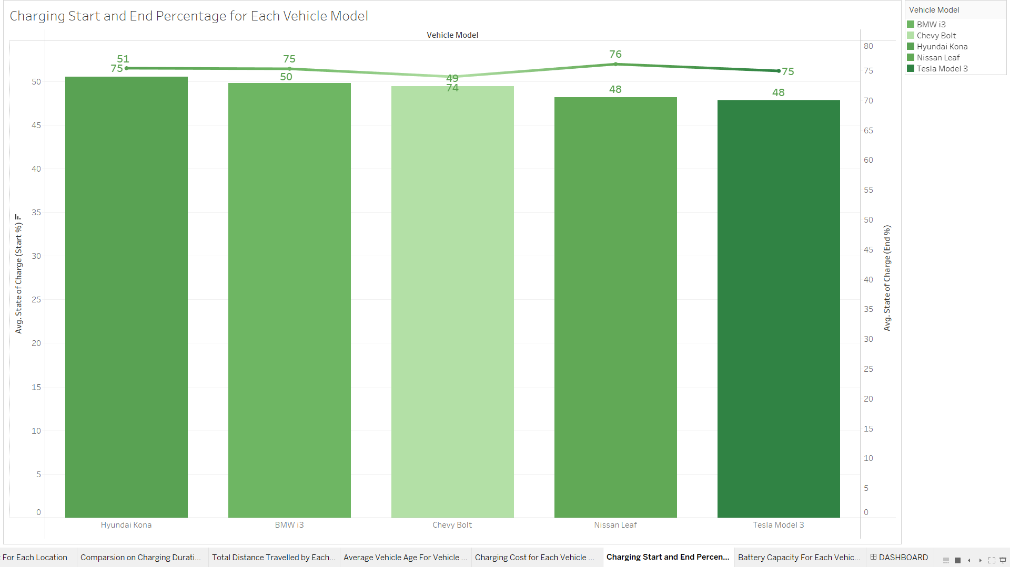

Slide 24
Average Battery Capacity by Model
Illustrates battery capacity variations, highlighting models with larger capacities.

Slide 25
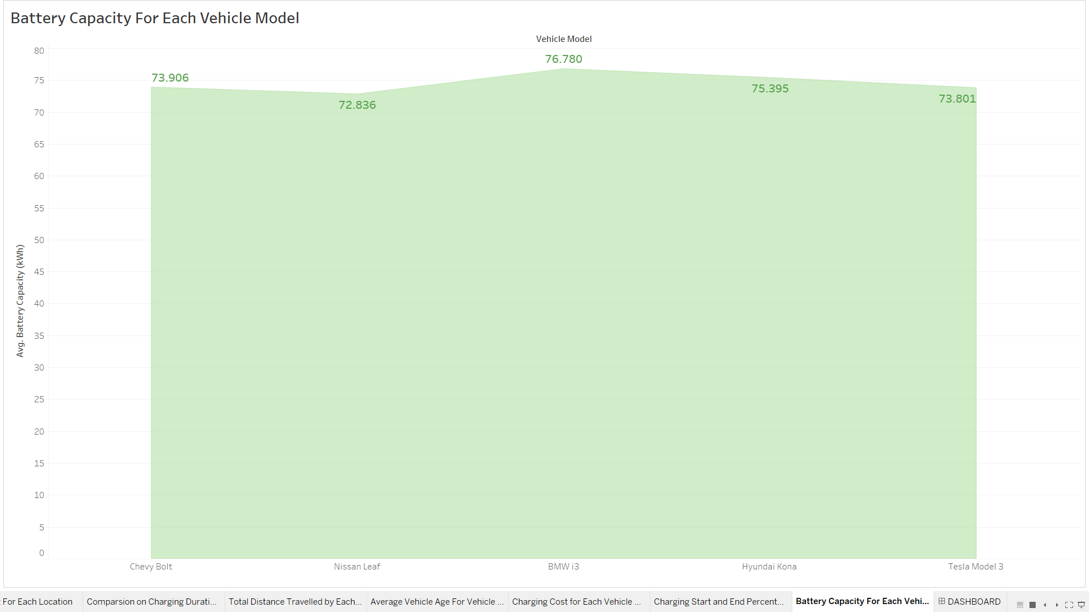

Slide 26
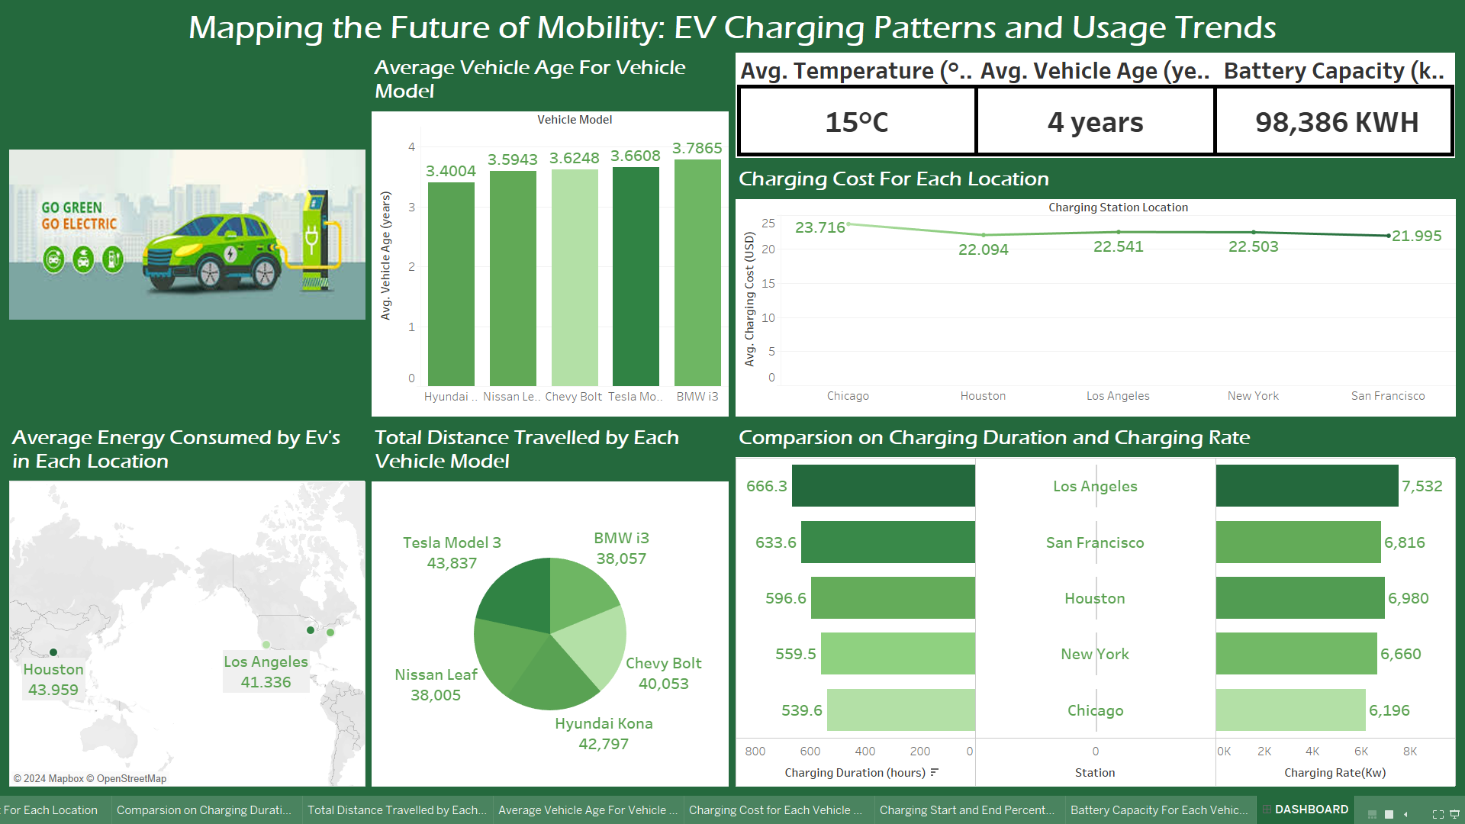
DASHBOARD

Slide 27
THANK YOU !

